Slide 1
3. Clustering

Slide 2
Clustering and Classification
Given a dataset of objects described by attributes, build a model that assigns objects to a class (or label)
a₂
a₂
descriptive model
(clustering)
a₁
a₁
no class
info
describe classes based on
similarity of attribute values
Notes:
For inferring global models of data collections there exist two types of approaches: descriptive and predictive modeling. We illustrate the difference among them by an example.
We assume that a set of data items (or objects) with two attributes a1 and a2 is given. Assume the global model we are interested in is a classification (or as often said labeling) of the data items.
In descriptive modeling we just know the data items, as indicated by the points in the 2-dimensional grid. A descriptive modeling technique, such as clustering, produces classes, which are not known in advance. For doing this it relies on some criteria that specify when two data items probably belong to the same class. Such a criteria is usually based on a similarity measure.

Slide 3
Clustering and Classification
Given a dataset of objects described by attributes, build a model that assigns objects to a class
a₂
a₂
predictive model
(classification)
a₁
a₁
class
info
predict classes based on
known attribute values
Notes:
A predictive modeling technique, such as classification, starts from a given classification (or labeling) of data items. Using that classification of the dataset the classification method infers conditions on the properties of the data objects, that allow to predict the membership to a specific class. For example, the prediction could be based on a partitioning of the attribute values along each dimension, as shown in the figure on the right. There, first attribute a1 is partitioned into two intervals, and for each of the intervals a different partitioning of the attribute a2 is used to determine the regions corresponding to classes. Misclassifications may occur as seen in the example.

Slide 4
Clustering
Model: partition a set of objects into clusters
Objects that belong to the same cluster are similar
Objects that belong to different clusters are dissimilar
Clustering belongs to unsupervised machine learning
Objects do not have class information
Notes:
Both clustering and classification aim at partitioning a dataset into subsets that have similar characteristics. Different to classification, clustering does not assume any prior knowledge, which are the classes/clusters to be searched for. There exist no class label attributes, that would tell which classes exist. Thus clustering serves in particular for exploratory data analysis with little or no prior knowledge.
One important application of clustering is information retrieval. The basic problem of information retrieval, i.e., finding a set of documents matching a query, can be interpreted as a clustering problem, where the goal is to find two clusters of documents, namely the cluster of relevant ones and the cluster of non-relevant ones. With the tf-idf similarity metrics in fact the tf-measure served to measure intra-cluster similarity for the two document clusters, whereas the idf-measure served to measure inter-cluster dissimilarity of the document clusters.

Slide 5
Usage of Clustering
Information retrieval
C₁: relevant to query, C₂, C₃: not relevant
Web content classification
C₁: sport, C₂: politics, C₃: economics ...
Customer behaviour analysis
C₁: diapers-beer buyers, C₂: Fri afternoon buyers ...
Image/video processing
C₁: image with faces, C₂: image with animals, …
Notes:
Clustering finds wide usage in many applications, where the different types of classes of objects (the labels) are not known in advance. The standard process is to first perform a clustering, and then inspecting the result. Inspection of the result may be performed manually (e.g. a user inspects some images in image clusters, and recognizes that in one cluster all, or most, images contain faces), or features of the objects in the cluster are extracted (e.g. frequent keywords if the objects are documents) and a user inspects the result. For example, if the keywords of documents in a cluster would turn around sports, the user would decide the cluster is on sports and would label it as sports.

Slide 6
Clustering
Problem
Given a database D with n data items described by m attributes
Find
Partition of D into k clusters
such that
Intra-cluster similarity is high
Inter-cluster similarity is low
Notes:
In its simplest formulation the clustering problem can be described in a way analogous to the vector space retrieval model. Given a database of data items that are represented by d-dimensional vectors (feature vectors), partition the database into k clusters. Not all elements need to be assigned to a cluster, then we consider those elements as noise in the data collection. Frequently used similarity measures include Euclidean distance and Manhattan distance.

Slide 7
Characteristics of Clustering Methods
a₂
Quantitative
Scalability: high n
Dimensionality: high m
a₁
a₂
a₂
a₂
No clusters visible
No clusters visible
Clusters visible
a₁
a₁
a₁
projection on a₁
projection on a₂
projection on diagonal
Notes:
Clearly, clustering methods have to work efficiently for large datasets. Another scalability problem clustering methods have to deal with is dimensionality: in general high-dimensional data (large m) is too sparsely distributed in its high-dimensional space in order to identify meaningful clusters. Therefore the data is often projected into a lower dimensional space. Doing so makes the clustering method sensitive to the choice of dimensions used for projection. The figure illustrates this problem for the case of 2 dimensions:
In the 2-dimensional representation we see clearly two clusters. However, if we project either on the a1 or a2 axes, there is no cluster structure visible. Only when we project on the diagonal we will also see the clusters in one dimension. Thus, when projecting into lower dimensions the choice of the subspaces used for projection is crucial. The number of choices for projection dimensions grows on the other hand combinatorial, which makes the problem computationally hard.

Slide 8
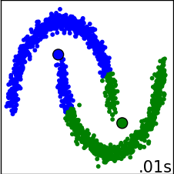
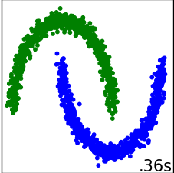
Characteristics of Clustering Methods
Qualitative
Different types of attributes
numerical, categorical
Type of shapes
spheres, hyperplanes ...
Notes:
Qualitative criteria for assessing the performance of a clustering method concern the ability of dealing with continuous as well as categorical attributes, and the type of clusters that can be found. Many clustering methods can detect only very simple geometrical shapes, like spheres, hyperplanes etc.

Slide 9
Characteristics of Clustering Methods
Robustness
Sensitivity to noise and outliers
Sensitivity to the processing order
User interaction
Incorporation of user constraints (e.g., number of clusters, maximal size of clusters)
Interpretability and usability
Notes:
Clustering methods can be sensitive both to noisy data and the order of how the records are processed. In both cases it would be undesirable to have a dependency of the clustering result on these aspects which are unrelated to the nature of data in question.
Finally, an important criterion is the ability of how well a clustering method can incorporate user requirements both in terms of information that is provided from the user to the clustering method (in terms of constraints), which can guide the clustering process, and in terms of what information is provided from the method to the user.

Slide 10
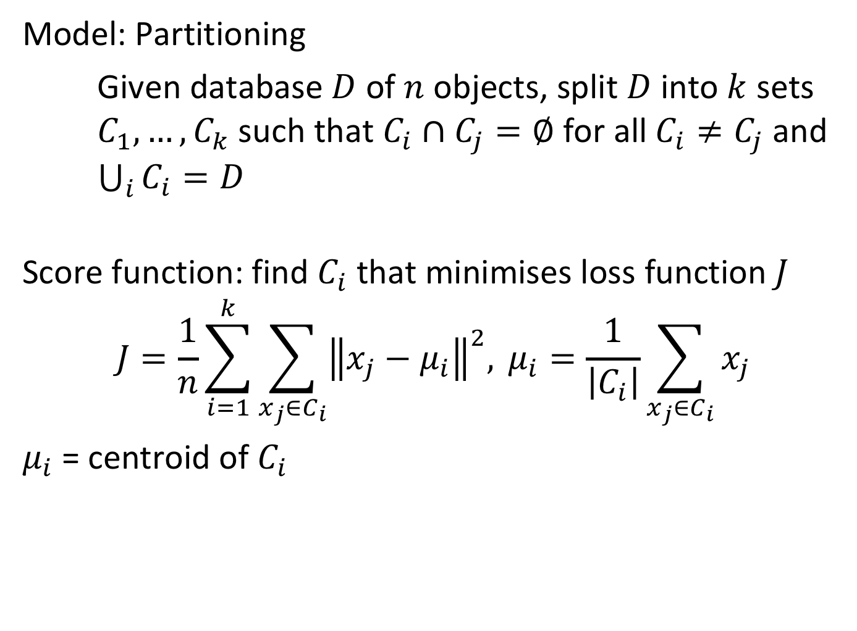
Partitioning Methods: Score Function
Model: Partitioning
Given database $D$ of $n$ objects, split $D$ into $k$ sets $C_{1},…,C_{k}$such that $C_{i}∩C_{j}=∅$ for all $C_{i}≠C_{j}$ and $\bigcup_{i}{C_{i}=D}$
Score function: find $C_{i}$ that minimises loss function $J$
$$J=\frac{1}{n}\sum_{i=1}^{k}{\sum_{x_{j}∈C_{i}}{{\left\|x_{j}−μ_{i}\right\|}^{2}, }}μ_{i}=\frac{1}{\left|C_{i}\right|}\sum_{x_{j}∈C_{i}}{x_{j}}$$
$μ_{i}$ = centroid of $C_{i}$
Notes:
More formally partitioning methods can be described as methods that attempt to optimize a cost function for a set of clusters. We show here the formulation for k-Means.
The cost function minimizes the distances of the cluster elements from the cluster representation, which is the centroid of the cluster.

Slide 11
Partitioning Methods
Optimal algorithm: enumerate all partitions and pick the best (not practical)
Heuristic algorithms:
K-means: cluster is represented by the point whose mean distance with the objects in the cluster is minimal
K-medoids: cluster is represented by the object whose mean distance with the objects in the cluster is minimal
K-medians: cluster is represented by the point whose median distance with all the objects in the cluster is minimal
Notes:
Since an exhaustive enumeration for finding the optimal partitioning is not practical various heuristic methods have been proposed. On class of algorithms are partitioning methods, that represent clusters be selected points and objects. The difference between using points and objects, is that points are not part of the dataset that is being clusters.
Partitioning methods are one of the most basic and widely used approaches to clustering. Partitioning methods attempt to partition the data set into a predetermined number k of clusters while maximizing the intra-cluster similarity.

Slide 12

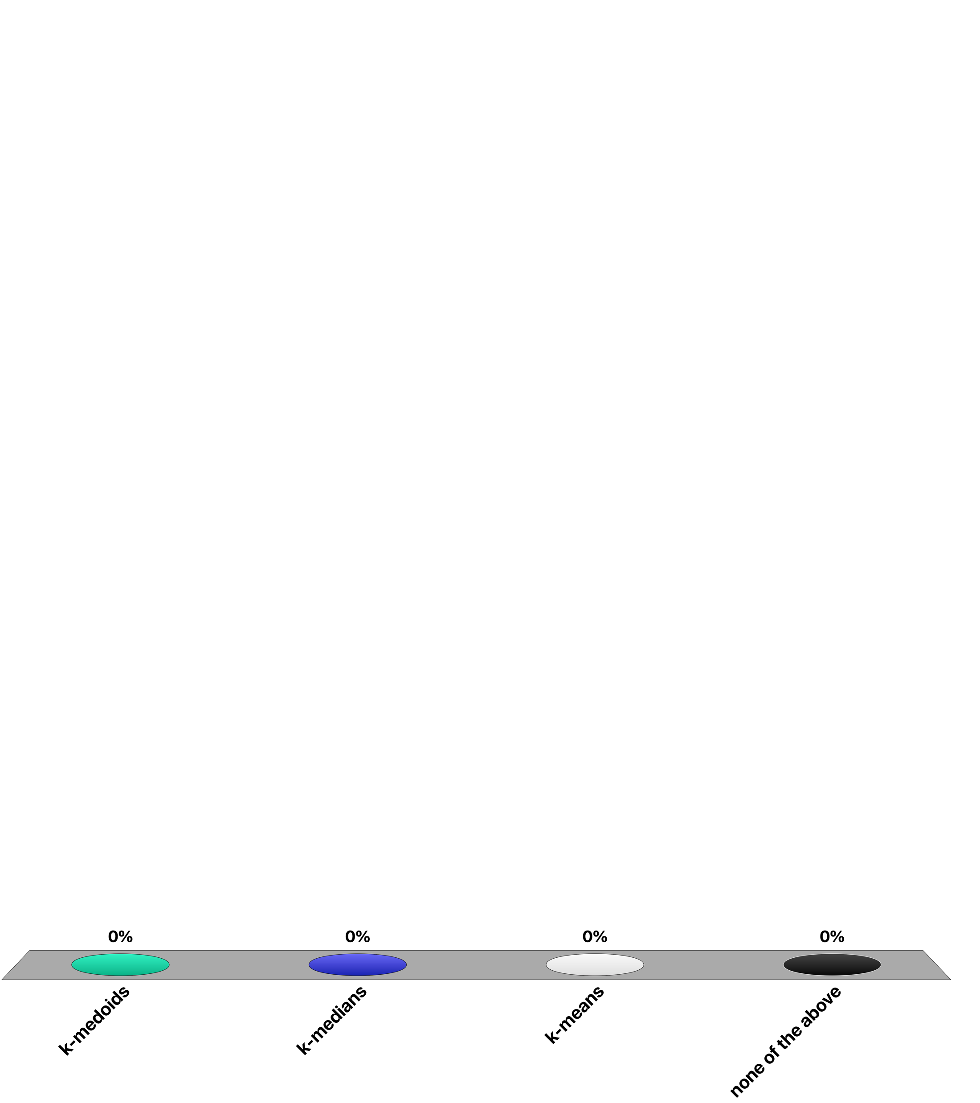
Suppose we have a dataset of pictures and we want to cluster them. Which partitioning algorithm seems more appropriate?
k-medoids
k-medians
k-means
none of the above

Slide 13
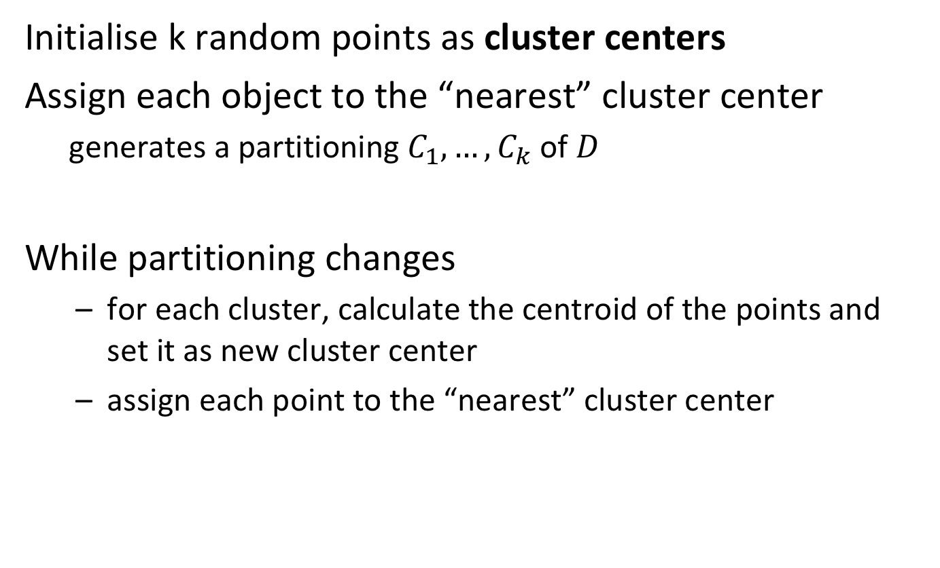
K-means Algorithm
Initialise k random points as cluster centers
Assign each object to the “nearest” cluster center
generates a partitioning $C_{1},…,C_{k}$of $D$
While partitioning changes
for each cluster, calculate the centroid of the points and set it as new cluster center
assign each point to the “nearest” cluster center
Notes:
In the widely used k-means algorithm clusters are represented by the centroid of their elements. The algorithm starts from some initial partitioning of the data. Initial centroids can be k random poins in the space or k objects (Forgy initialisation). Then, it iteratively reassigns data points to the closests centroids till the algorithm converges. The distances are computed according to a given metrics, e.g. Euclidean distance.

Slide 14
K-means Algorithm: Example
Step 1
Step 2
Step 3
Step 4
Step 3
Step 4

Slide 15
Characteristics of K-means
Advantages
Efficient: O(tkn)
n is #objects, k is #clusters, t is #iterations (k,t << n)
Converges fast
Shortcomings
Often terminates at a local minimum
Needs a distance function to compute the mean
Needs to specify k in advance
Does not handle noisy data and outliers
Clusters only have convex shapes
Notes:
We assess here the properties of k-means following the list of criteria for evaluating clustering methods that we have introduced earlier.

Slide 16
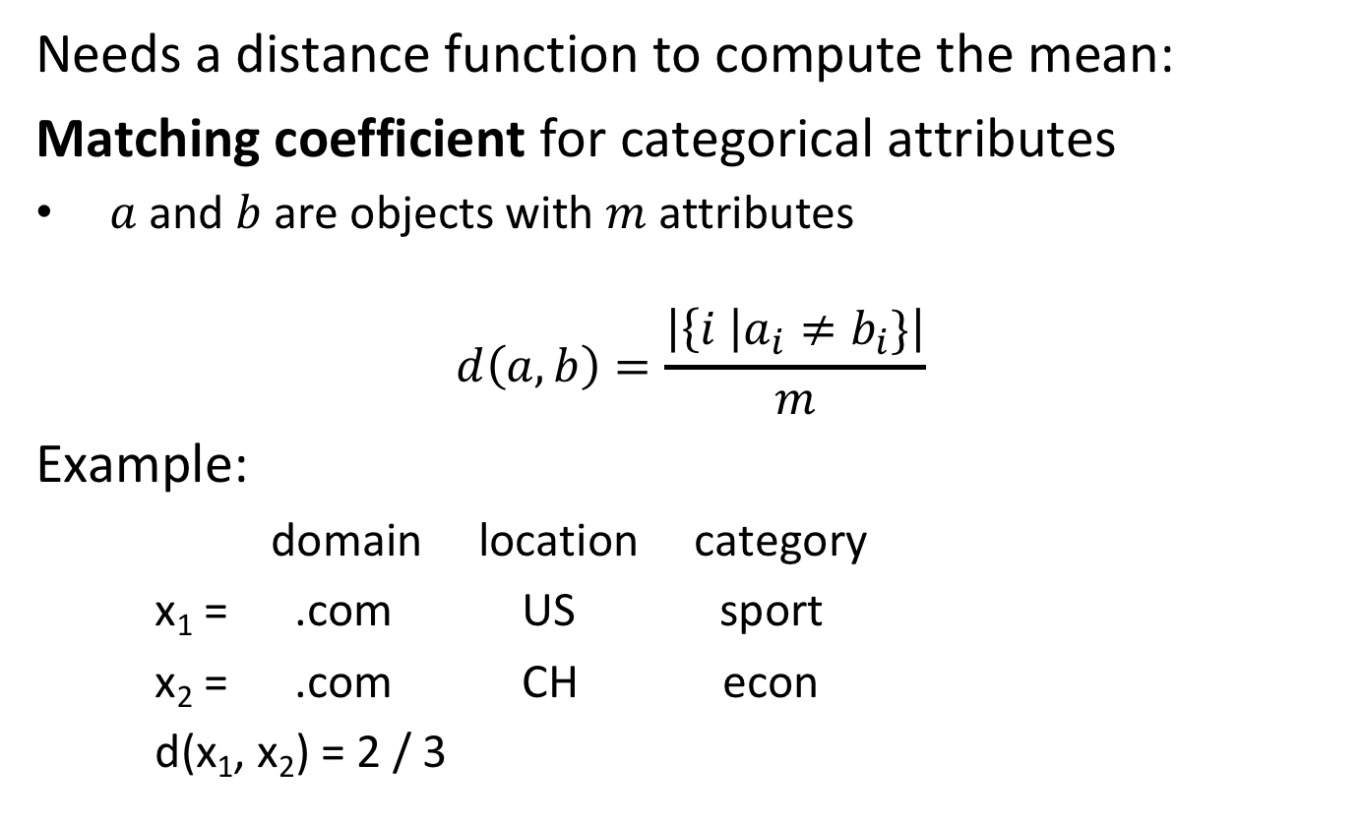
K-means for Categorical Attributes
Needs a distance function to compute the mean:
Matching coefficient for categorical attributes
$a$ and $b$ are objects with $m$ attributes
$$d\left(a,b\right)=\frac{\left|\left\{i \right|a_{i}≠b_{i}\}\right|}{m}$$
Example:
domain location category
x₁ = .com US sport
x₂ = .com CH econ
d(x₁, x₂) = 2 / 3
Notes:
One of the short-comings of k-means is that it relies on the existence of a distance function. Thus, when the attributes are categorical such a distance function needs to be constructed as it is not naturally available. A simple approach to define a distance function in this setting is to count the number of attribute values that do not match (mismatches) and divide by the total number of attributes. Note that this function is a distance function, as it satisfies the properties of a distance function:
d(x,y) ≥ 0
d(x,y) = 0 iff x = y
d(x,y) = d(y,x)
d(x,z) ≤ d(x,y) + d(y,z)

Slide 17
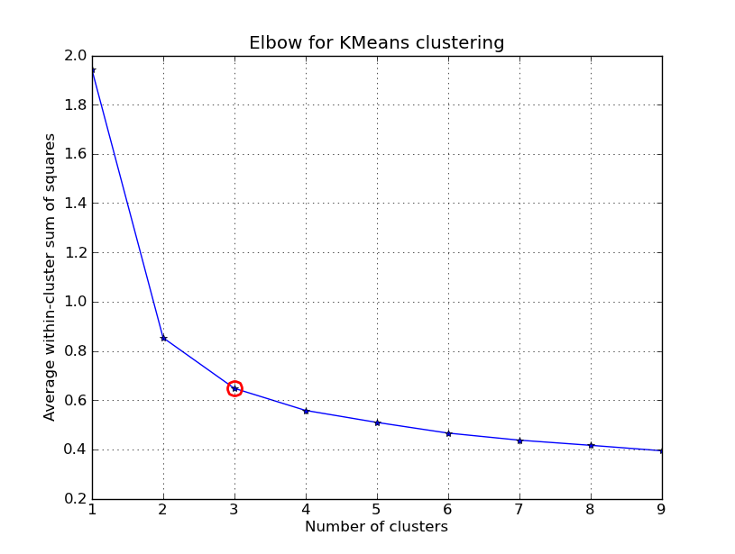
Choosing Parameter k for K-means
Needs to specify model parameter k in advance
Execute for k = 1, 2, 3 ...
Plot the score J against k
Pick k such that J(k) ∼ J(k+1)
Notes:
To find a suitable number of k we rely on the following intuition. The higher the value of k, the lower the within-cluster sum of squares. However, creating too many clusters is useless. Thus we want to find the smallest k after which the within-cluster sum of squares decreases “slowly” (elbow method)

Slide 18
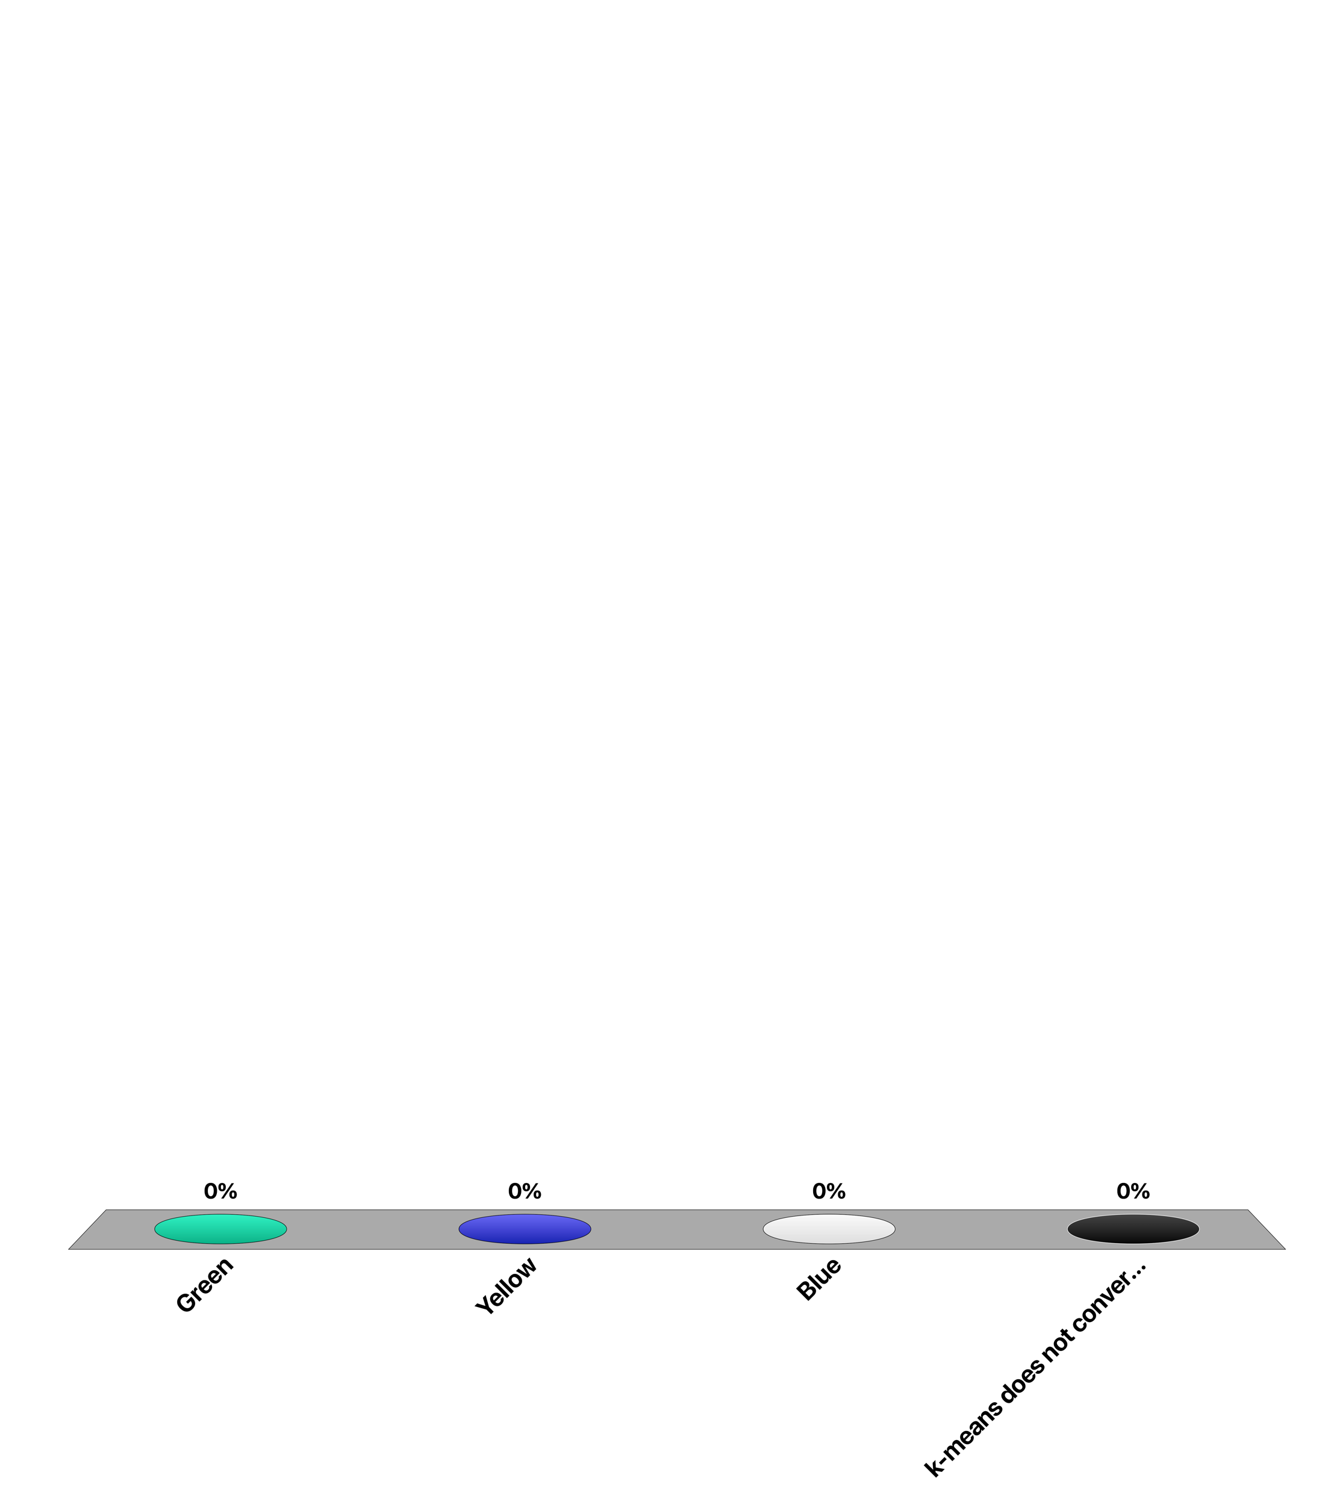
What will be the color of the middle points after convergence (k=3)?
Green
Yellow
Blue
k-means does not converge

Slide 19
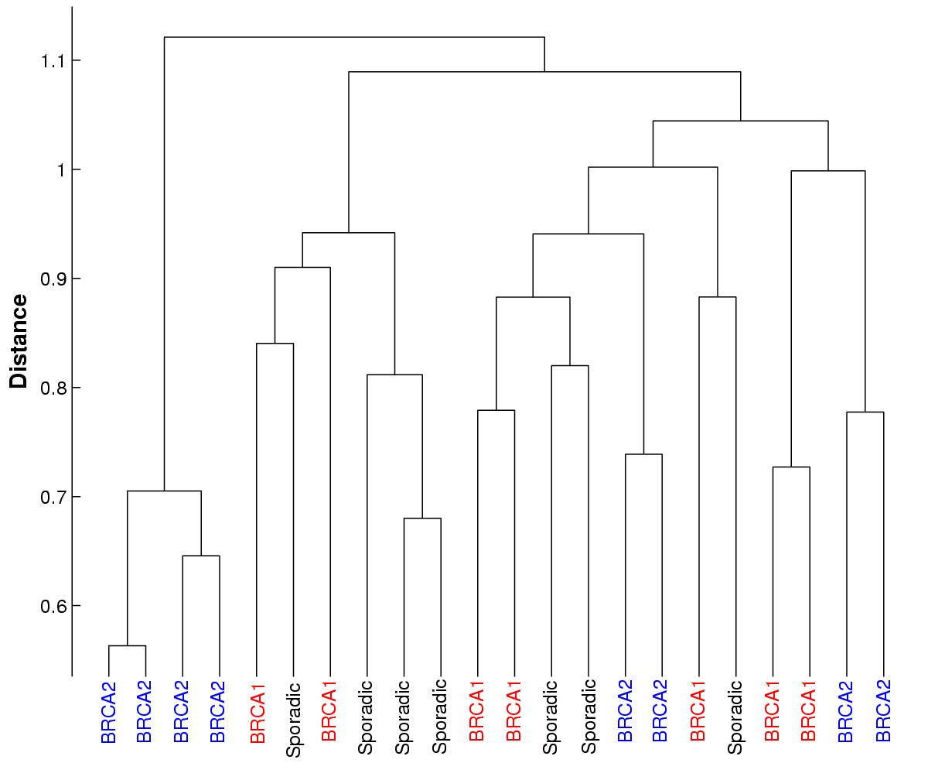
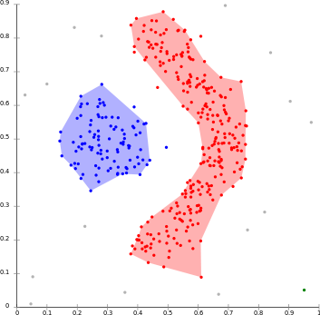
Advanced Clustering
Distance measures for mixed attributes
Other methods
Density-based clustering
Hierarchical clustering
Online incremental clustering
Notes:
There is a lot of existing work on clustering, including more complex distance functions for mixed (numerical + nominal) attributes and similarity functions that computes “how similar” are two objects (e.g., cosine similarity)
There exists also other methods beyond partitioning. Density-based methods are able to discover clusters of arbitrary shape by checking if the number of objects in the neighbourhood of a given objects is above a certain density threshold. Bottom-up hierarchical methods starts from a number of cluster equal to the number of objects (i.e., each object is a cluster) and then iteratively merge similar clusters. Online incremental methods create clusters in an incremental way, by placing each new incoming object into an existing cluster or into a new one.

Slide 20
Density-based Clustering - DBSCAN
Clustering based on a local, density-based criterion
Properties
Discovers clusters of arbitrary shape
Handles noise
Clusters in one scan
No predetermined number of clusters
Model parameters: density parameters
Notes:
We have identified a number of shortcomings of K-means. Density based clustering addresses a number of those, in particular the need to specify the number of clusters in advance, the possibility to discover non-convex clusters, handling local minima and handling of outliers. Of course, this will not come for free: on the one hand also density-based clustering requires specification of (other) model parameters, and as we will see, the are more costly.

Slide 21


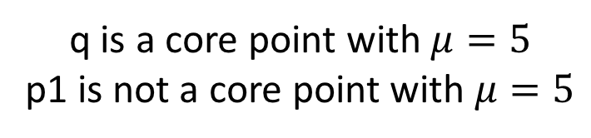
Basic Notions
We assume a distance metric $d$ is given
$ε$- neighborhood: $N_{ε }\left(q\right)=\left\{p|d(p,q)\text{ < }ε \right\}$
A point $q$ is a core point if ${|N}_{ε }\left(q\right)|≥μ$
$ε$ and $μ$ are model parameters
p1
q is a core point with $μ=5$
p1 is not a core point with $μ=5$
q
$$ε$$
Notes:
We first introduce the basic notions used in density-based clustering. For each point we can consider its epsilon-neighborhood. If we find within such a neighborhood a certain number of points, we consider such a point as being inside a cluster and call it a core point. The definition of core points also introduces the two model parameters the density-based clustering relies on, epsilon and mu.

Slide 22
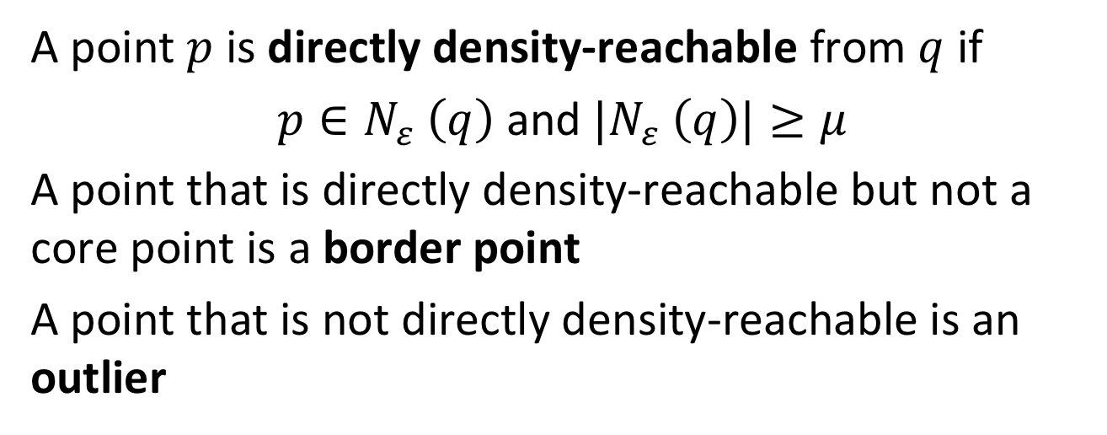

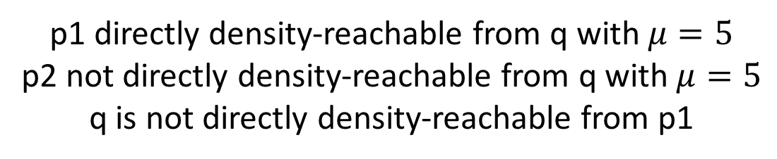
Basic Notions: Directly Density-Reachable
A point $p$ is directly density-reachable from $q$ if
${p∈N}_{ε }\left(q\right)$ and ${|N}_{ε }\left(q\right)|≥μ$
A point that is directly density-reachable but not a core point is a border point
A point that is not directly density-reachable is an outlier
p1 directly density-reachable from q with $μ=5$
p2 not directly density-reachable from q with $μ=5$
q is not directly density-reachable from p1
p1
p2
q
$$ε$$
Notes:
Based on the notion of core points, we can next introduce the notion of directly-density reachable. A point is directly-density reachable if it is in the neighborhood of a core point. Since not every point in the neighborhood of a core point is a core point itself, we identify a second type of points, border points. They are directly-density –reachable, informally this means they are part of a cluster, but not core points. Thus they define the border of a cluster. In addition, certain points might not be directly-density reachable at all, these are considered as outliers.

Slide 23
Directly Density-Reachable: Properties
Direct density-reachability induces a directed graph on the points
p1
p2
q
Notes:
Direct-density reachable induces a directed graph structure on the points. Note that border points are connected with a simple directed link coming from a core point, whereas two core points are connected by bi-directional links.

Slide 24
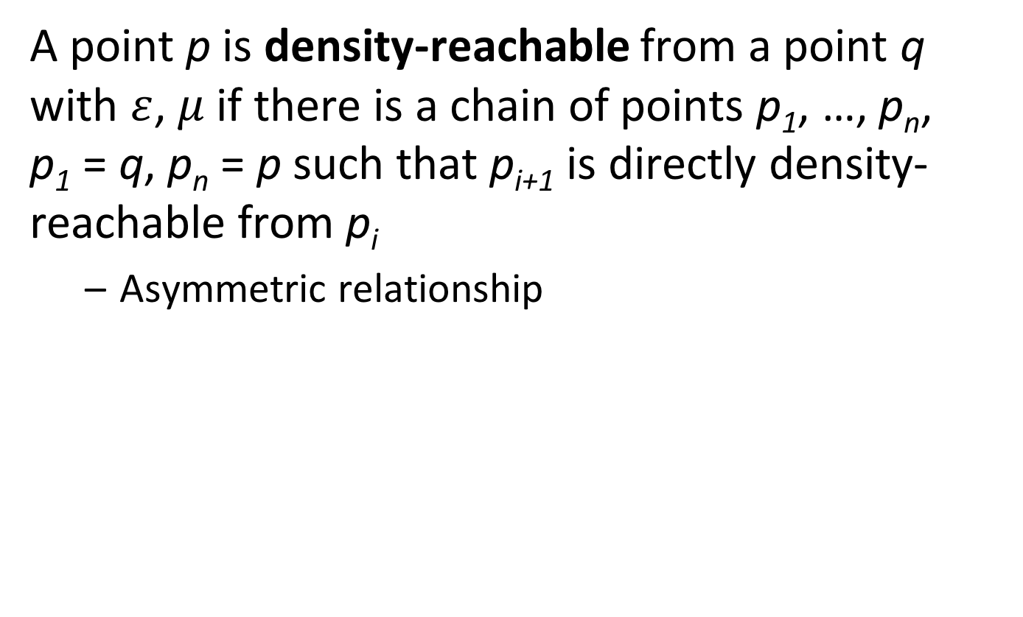
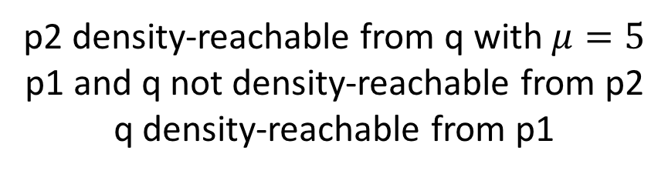
Basic Notions: Density-Reachable
A point p is density-reachable from a point q with $ε$, $μ$if there is a chain of points p₁, …, p_{n}, p₁ = q, p_{n} = p such that p_{i+1} is directly density-reachable from p_{i}
Asymmetric relationship
p2 density-reachable from q with $μ=5$
p1 and q not density-reachable from p2
q density-reachable from p1
p1
p2
q
Notes:
Next we consider the transitive closure of the direct-density reachability, resulting in the notion of density-reachability. A point is density-reachable when it can be reached through a chain of direct density reachability links. Note that this relationship is asymmetric. A border point can be density reachable from a core point, but the inverse is not true, since the border point has no reverse link.

Slide 25

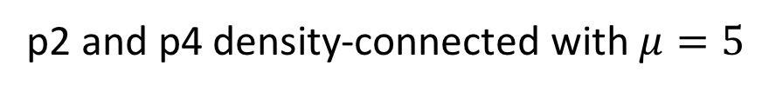
Basic Notions: Density-Connected
A point p is density-connected to a point q with $ε$, $μ$if there is a point r such that both, p and q are density-reachable from r with $ε$, $μ$
Symmetric relationship
p1
p2 and p4 density-connected with $μ=5$
p4
p2
p3
q
Notes:
To introduce a symmetric relationships that connects all points within the same cluster, we define the notion of density-connected. Two points are density connected if the can reached both from the some (core) point. This allows then also to connect different border points.

Slide 26
Clusters and Noise
Definition: a cluster C satisfies
Maximality: if q in C is a core point, and p is density reachable from q, then also p is in C
Connectivity: any two points in C must be density connected
Properties
Connectivity implies that a cluster contains at least one core point
The set of clusters is unique
Clusters are not necessarily disjoint
Notes:
Now we have all the notions in order to define what a cluster is in the context of density-based clustering. The basic idea is that density-connected points are considered to belong to the same cluster and that points not density-connected to any other point are considered as noise. To make the definition precise we can state the two properties of maximality and connectivity. With this two properties one can prove that the clusters are uniquely defined,

Slide 27
DBSCAN Algorithm: Initialization
Construct a directed graph G using direct density-reachability
Initialize
V_{core} = set of core points
P = set of all points
set of clusters C = {}
Notes:
We have now introduced the prerequisites to describe the DBSCAN algorithm for density-based clustering. The algorithm starts by first computing the direct density-reachability graph. This requires to scan the whole database and to compute the neighborhoods of each point. Without any further optimizations this requires each point with every other point, thus a cost that is square in the size of the database. Spatial indexing could be used to reduce this cost. Then three variables are initialized, the set of all core points, the set of all points and the set of clusters found, which initially is empty.

Slide 28
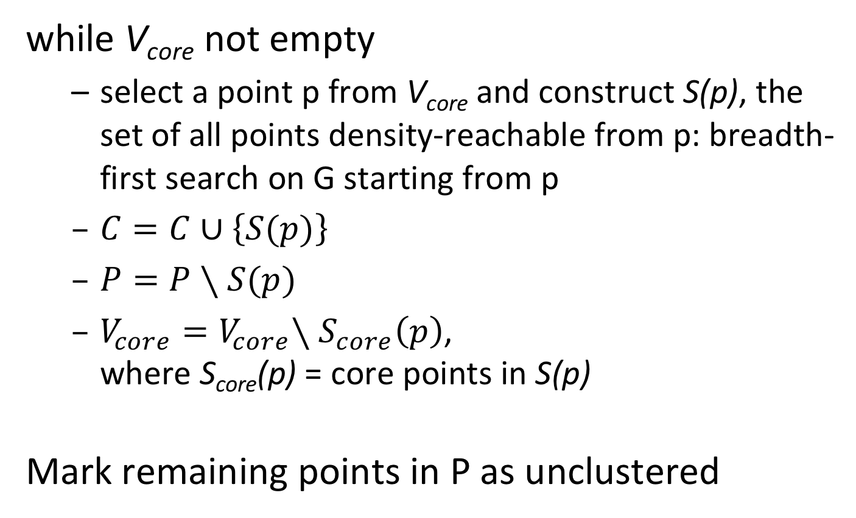
DBSCAN Algorithm: Cluster Construction
while V_{core} not empty
select a point p from V_{core} and construct S(p), the set of all points density-reachable from p: breadth-first search on G starting from p
$C=C∪\left\{S(p)\right\}$
$P=P∖S(p)$
$V_{core}{=V}_{core}∖S_{core}\left(p\right)$, where S_{core}(p) = core points in S(p)
Mark remaining points in P as unclustered
Notes:
For constructing clusters the algorithm packs any core point that has not yet been included in a cluster, and computes all points that are density-reachable from that bound. This set of points can be found be performing a breadth-first search in the directed graph G starting from p and this will return a uniquely defined set of points forming a cluster. After such a cluster has been found the three variables are V_core, C, and P are updated. The new cluster is added to the set of clusters C, the points that have been included in the cluster are removed from P and thus are known to be assigned to a cluster, and the core points contained in the new cluster are removed from V_core and can thus no longer be used as starting point to find a new cluster. Once V_core is empty, we know that no more new clusters can be found. Still, the set P might be non-empty. This means, that those points are outliers that do not belong to any clusters and they are marked as such. Note that the set P is not maintained to indicate the points that need still to be clustered (some points might belong to multiple clusters), but to check which points become never part of a cluster and are finally identified as noise.

Slide 29
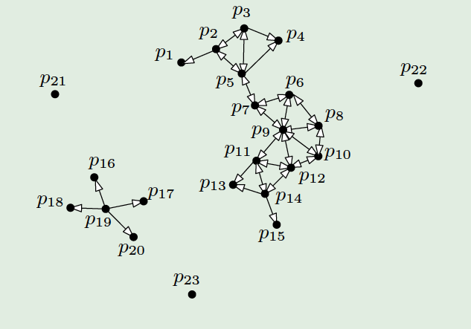
Example
Source: Yufei Tao, Chinese University of Hong Kong
First cluster: choose p₂ and compute S(p₂) = {p₁,…,p₁₅}
Then, V_{core} = {p₁₉}
Second cluster: {p₁₆,…,p₂₀}
p₂₁,…,p₂₃ are outliers
Notes:
This example illustrates how DBSCAN works. Initially V_core would be {p2, p3, …, p19}. If we select p2 as first core point to construct a cluster we obtain the “big” cluster S(p2). Then the only remaining core point is p19, which gives the second cluster. The remaining points are outliers. The figure also illustrates the difference between core and border points. For example for the big cluster the border points are p1, p4 and p15.

Slide 30
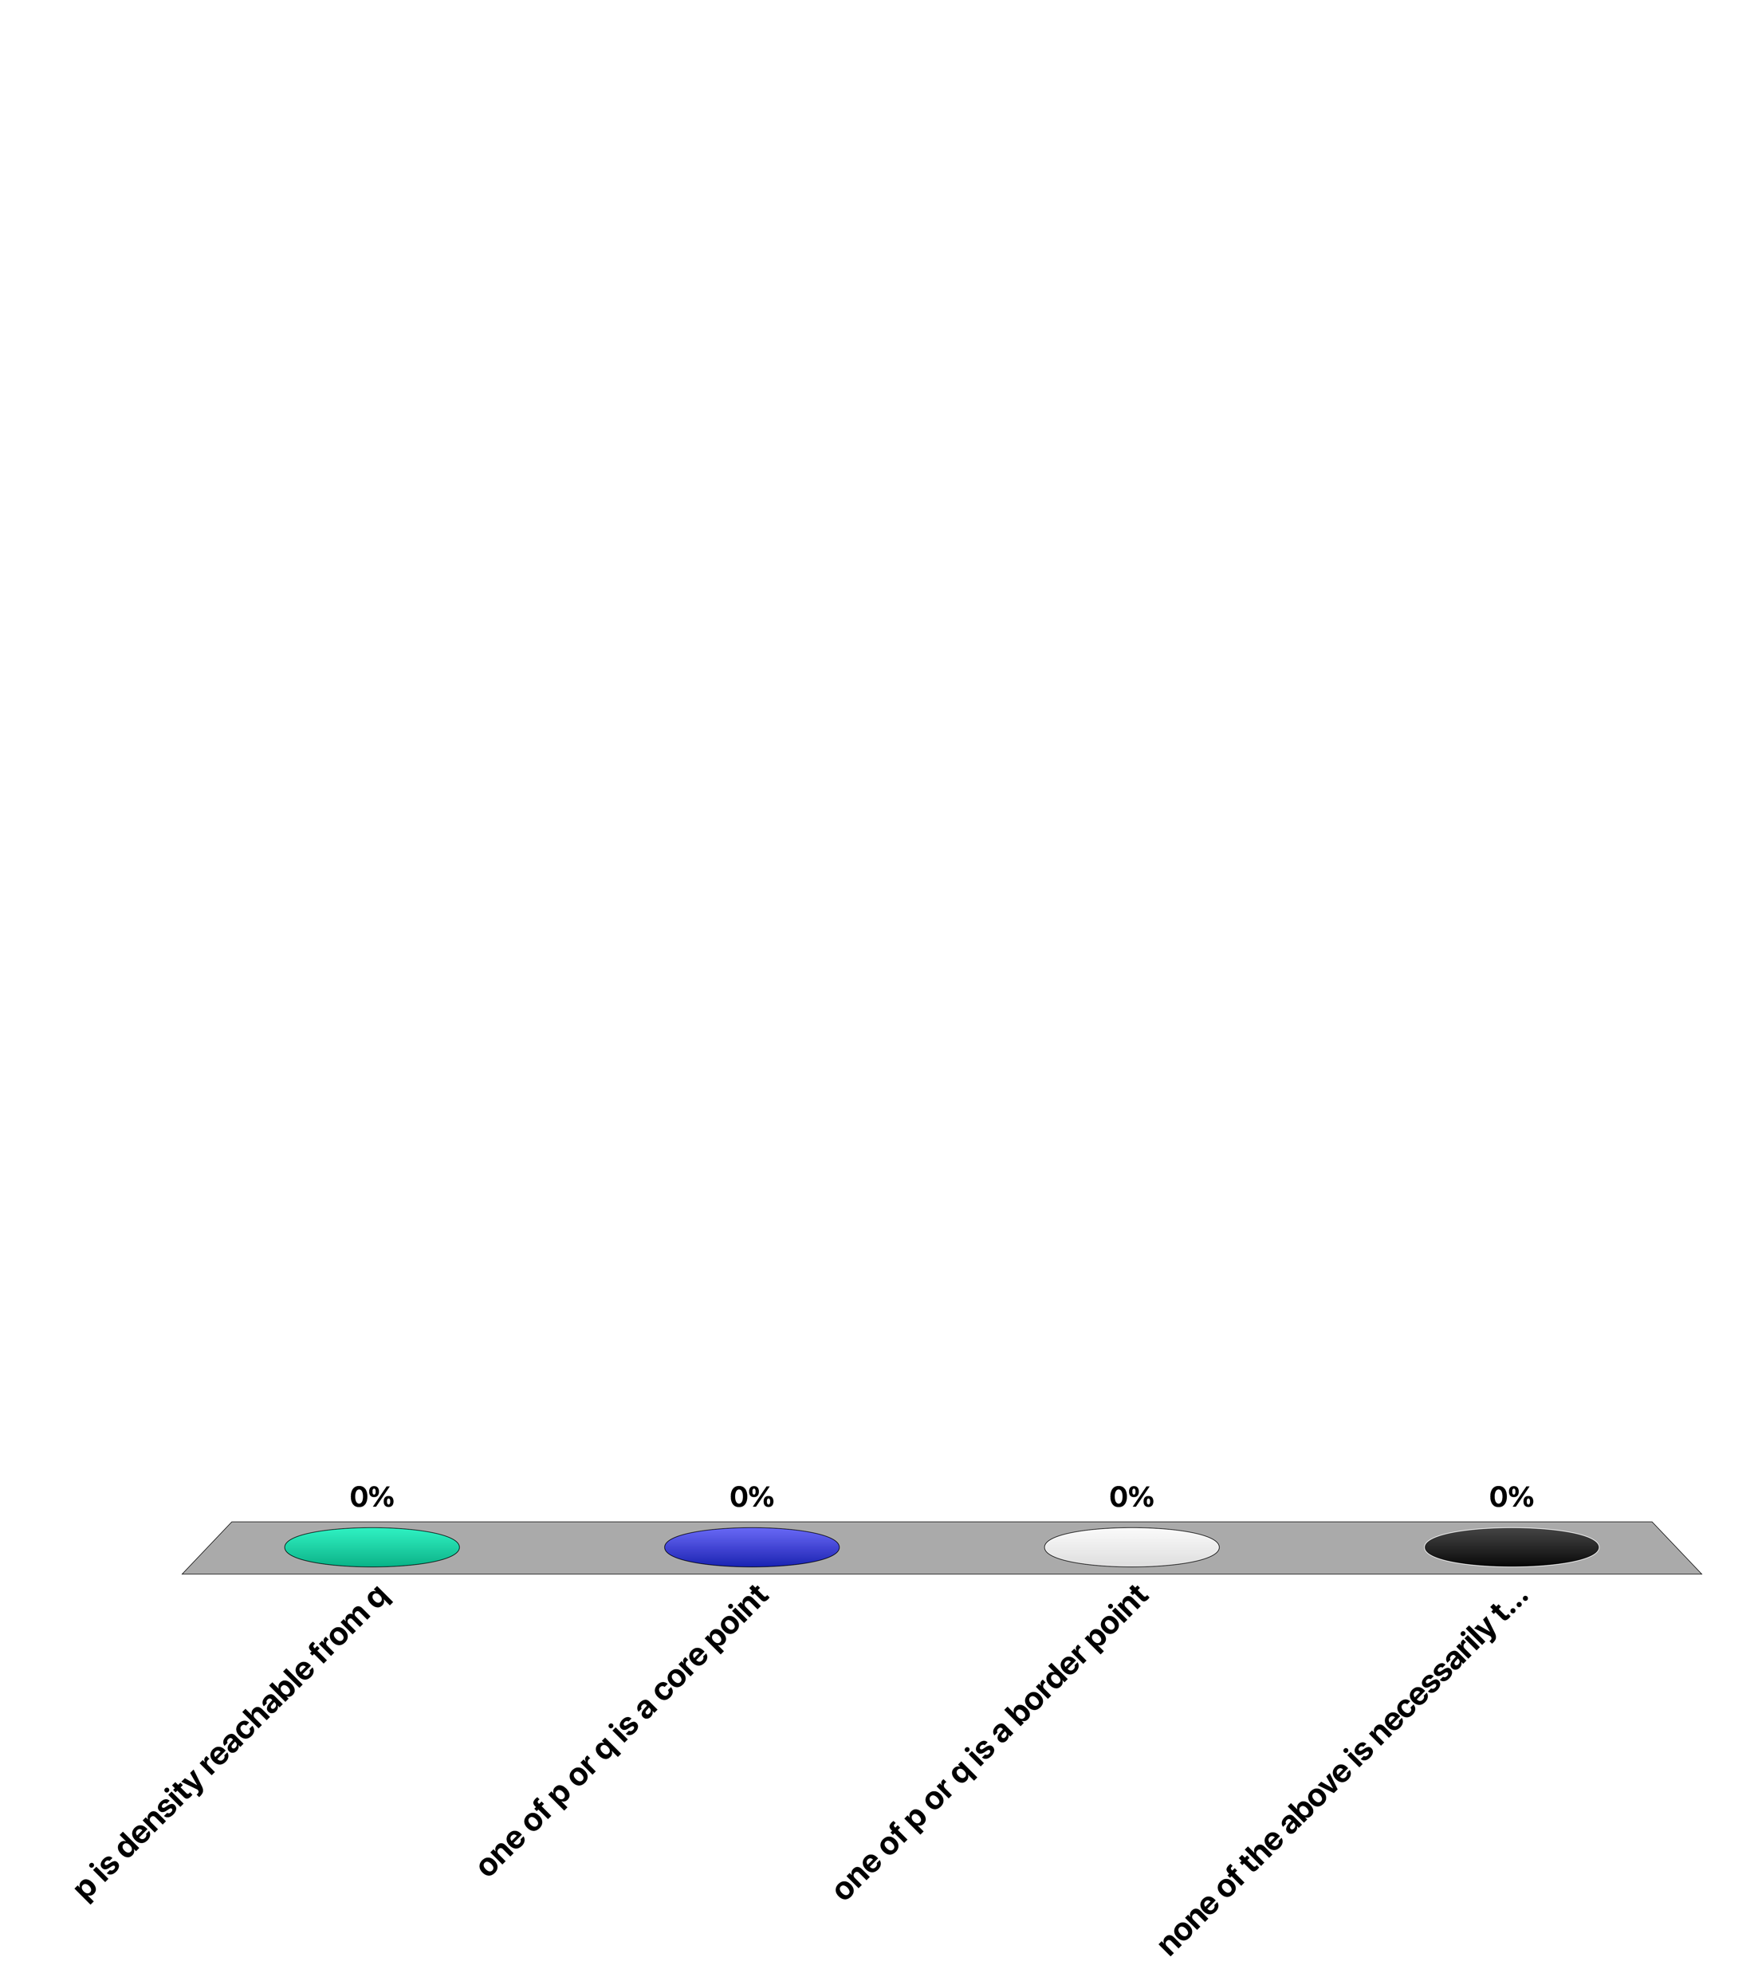
If p and q are density connected, then …
p is density reachable from q
one of p or q is a core point
one of p or q is a border point
none of the above is necessarily true

Slide 31
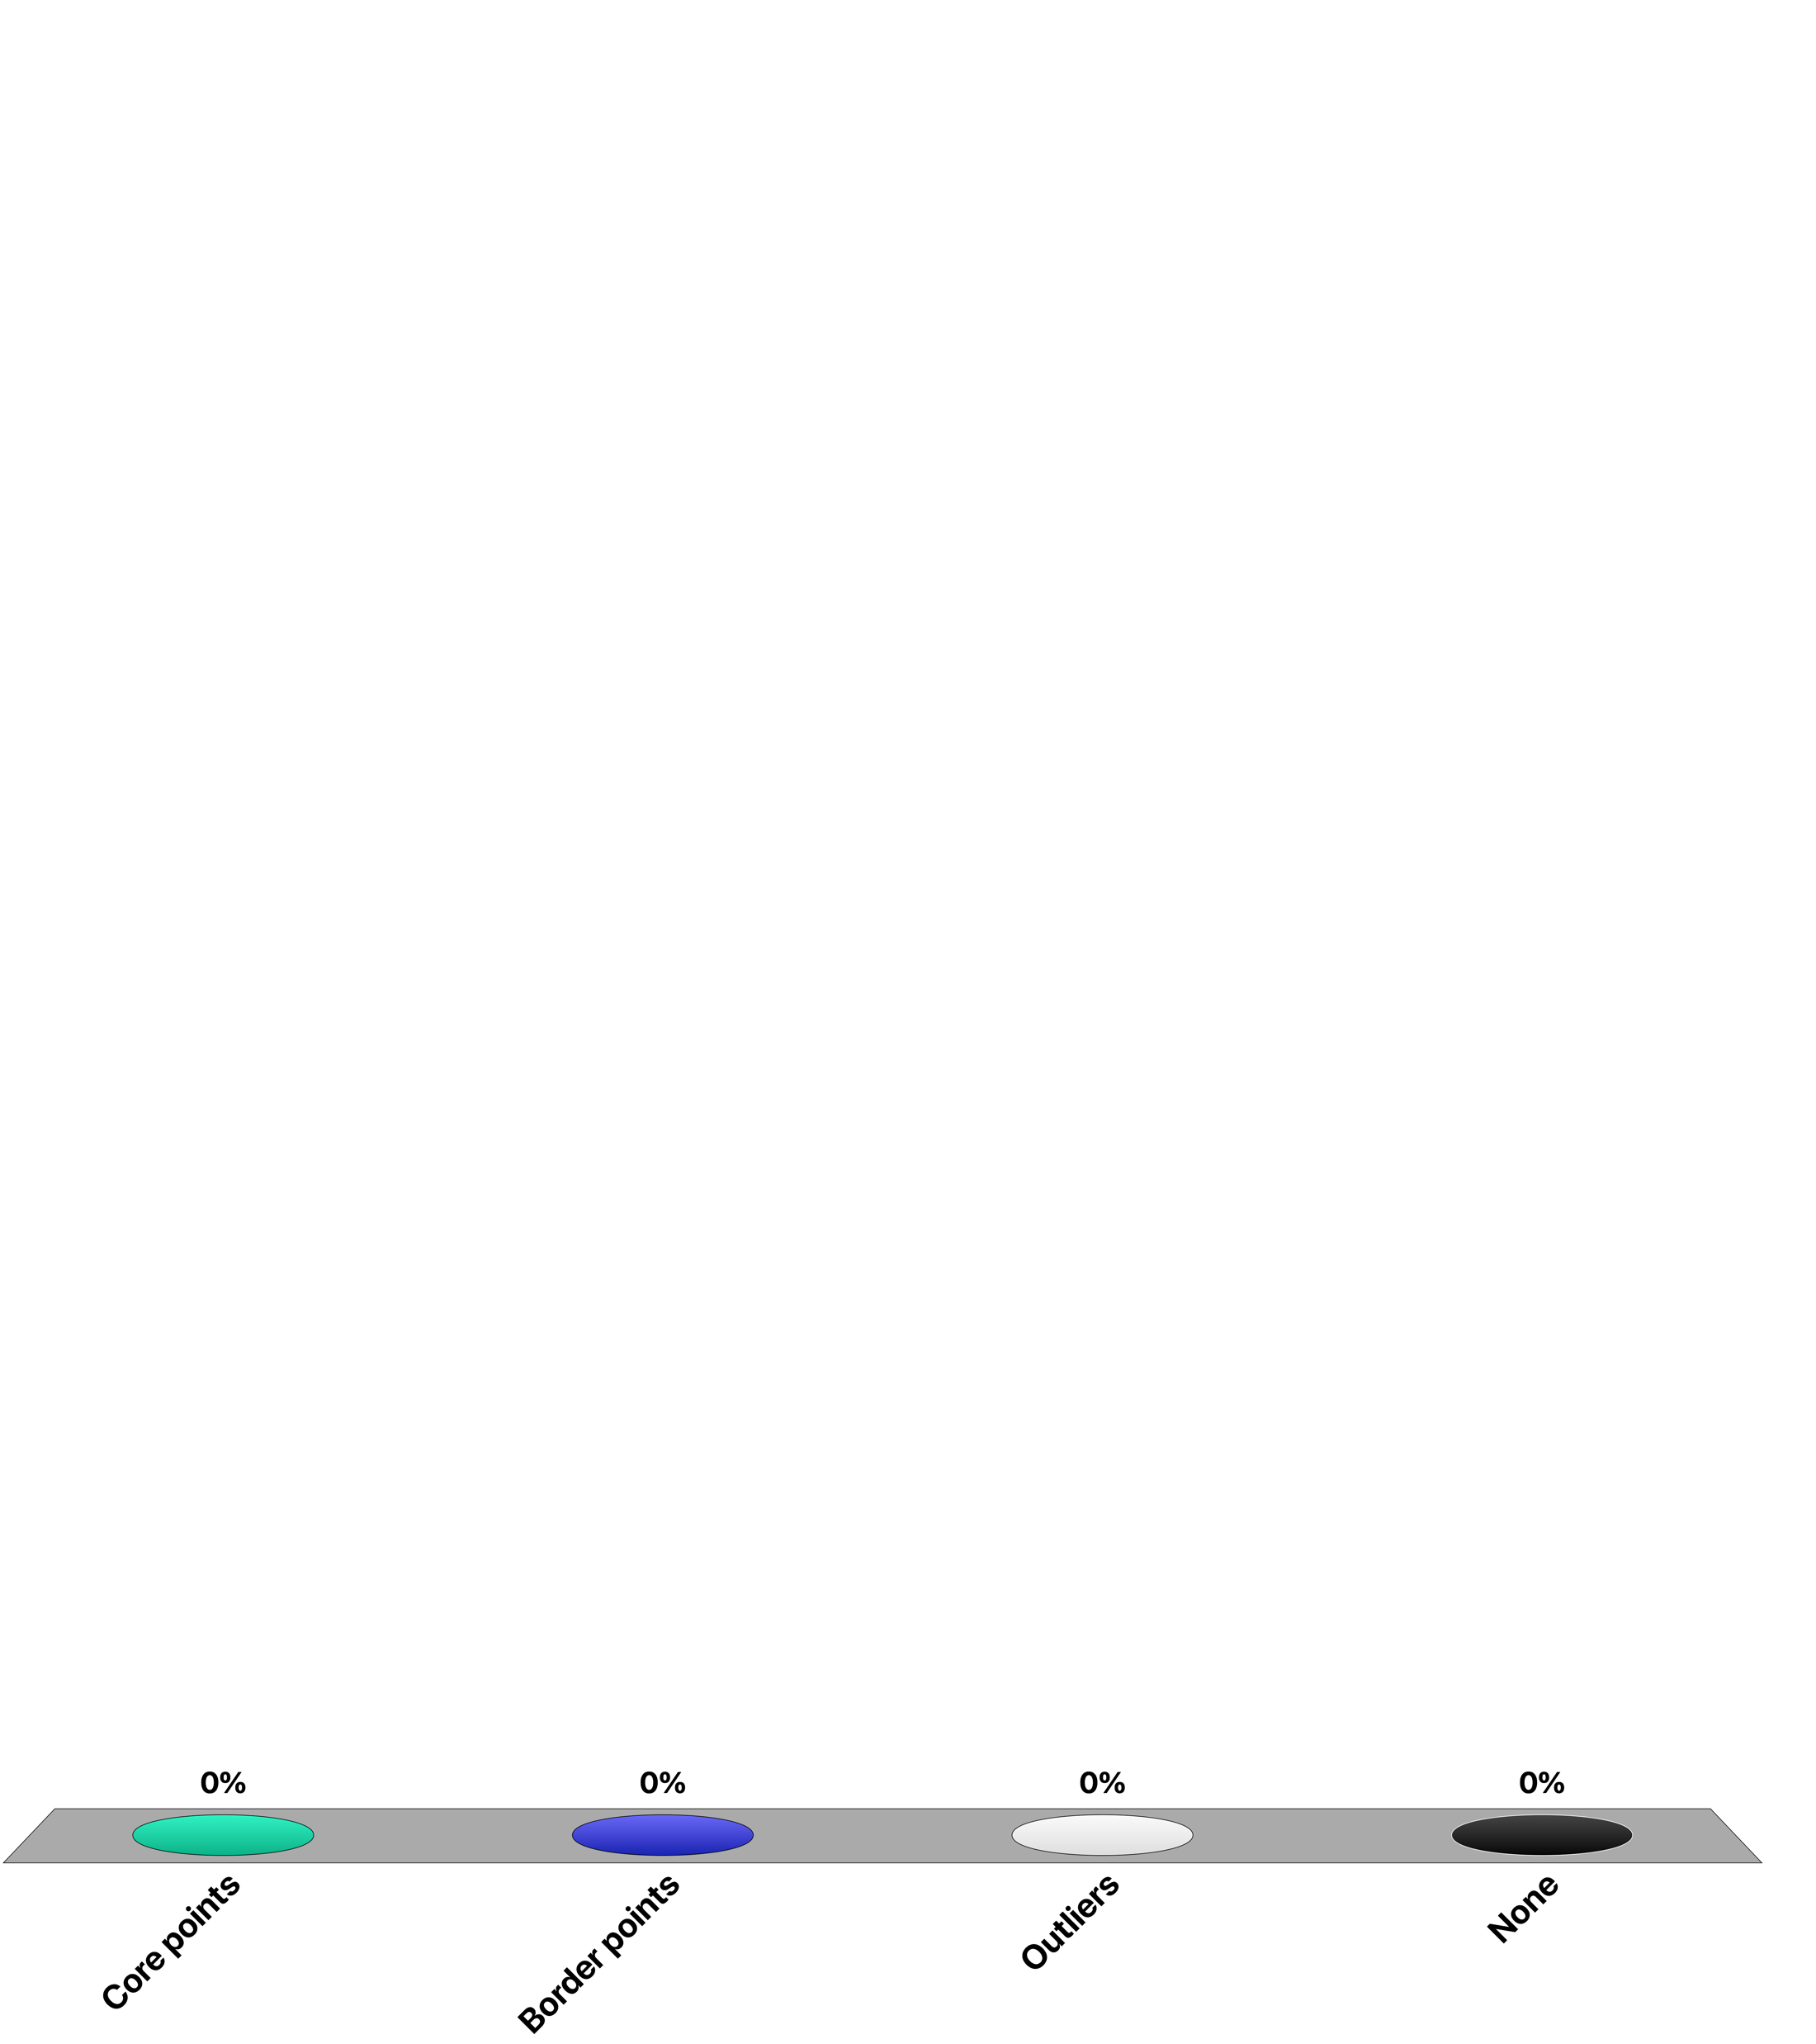
In density-based clustering, which points can belong to multiple clusters?
Core points
Border points
Outliers
None

Slide 32
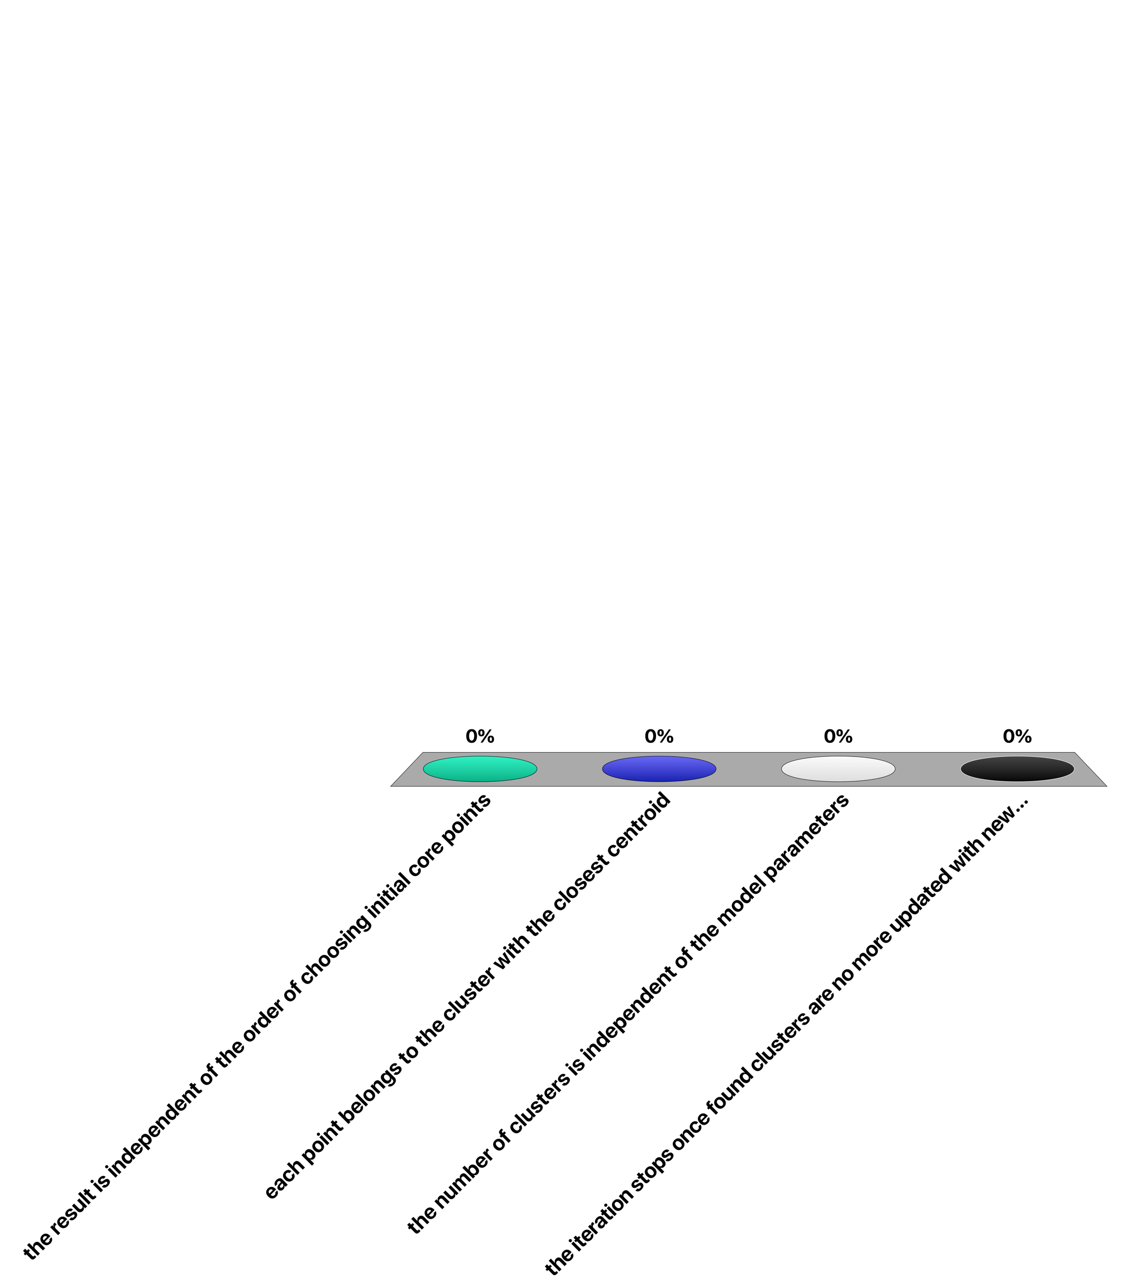
When executing DBSCAN …
the result is independent of the order of choosing initial core points
each point belongs to the cluster with the closest centroid
the number of clusters is independent of the model parameters
the iteration stops once found clusters are no more updated with new points

Slide 33
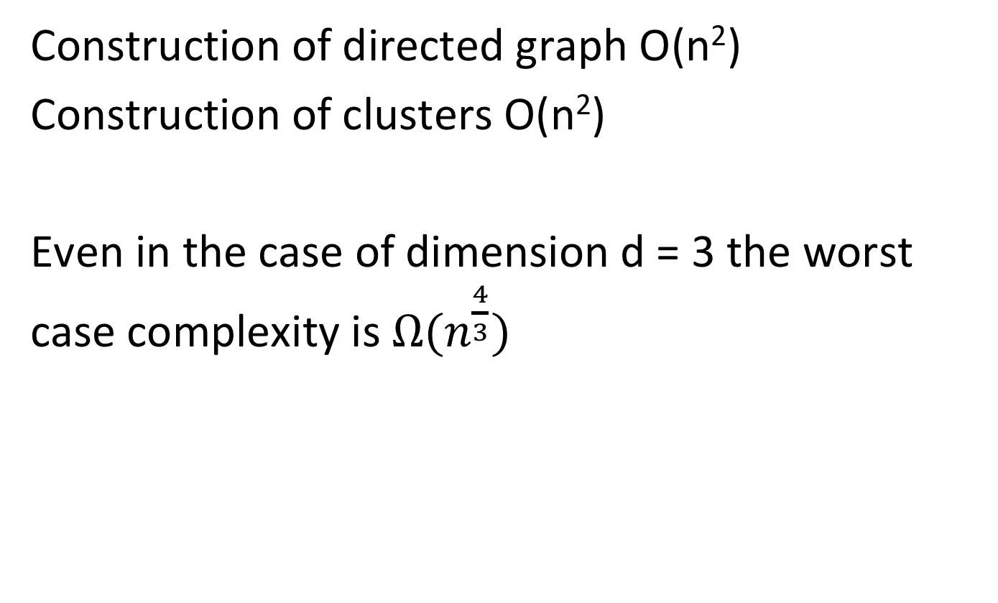
DBSCAN Complexity
Construction of directed graph O(n²)
Construction of clusters O(n²)
Even in the case of dimension d = 3 the worst case complexity is $Ω(n^{\frac{4}{3}})$
Notes:
The complexity of the DBSCAN algorithm is O(n^2) which in practice makes it expensive for larger datasets. It is an open problem in data mining finding better algorithms for density clustering, ideally algorithms with running time O(n log(n)^c) for some constant c. It turns out that even in dimension 3 this cannot be achieved, unless some theoretical problems are solved through breakthroughs. The problem can be reduced to the unit-spherical emptiness checking problem, for which today the best algorithm has complexity O( n^4/3 log^4/3 n)

Slide 34
Evaluating Clustering Quality
Problem: Often no ground truth available
Do not know what is the “correct” clustering
“Solution”
define measures that characterize of how the properties of high intra-cluster similarity and low inter-cluster similarity are achieved
But may consider also other properties of clusters

Slide 35
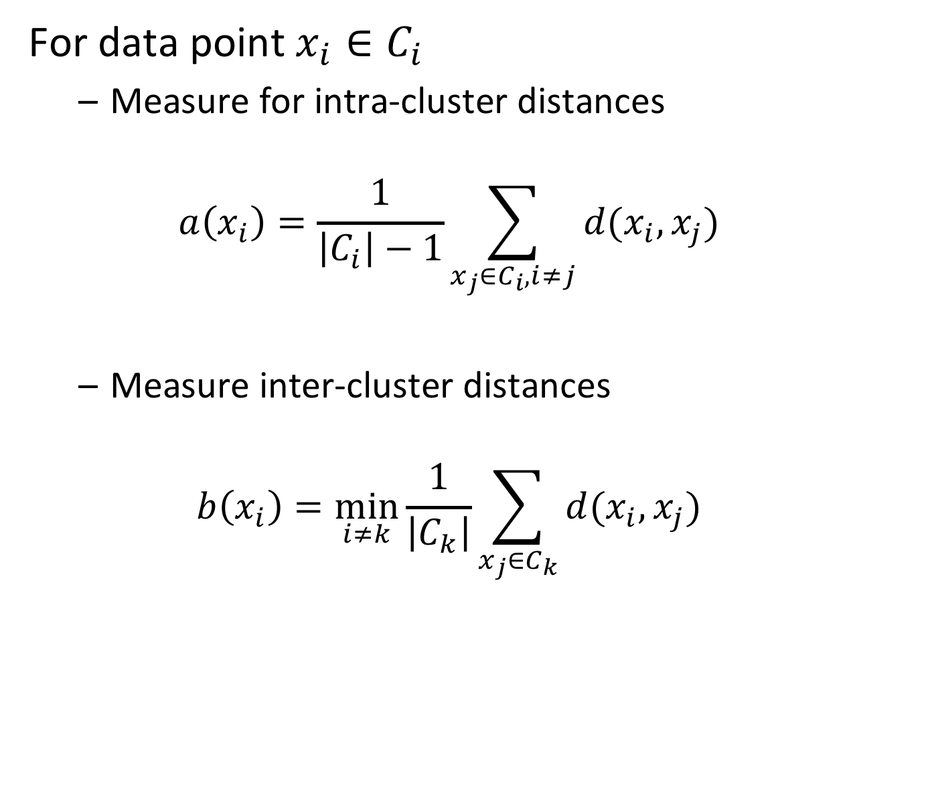
Example: Average Silhouette Width ASW
For data point $x_{i}∈C_{i}$
Measure for intra-cluster distances
$$a\left(x_{i}\right)=\frac{1}{\left|C_{i}\right|−1}\sum_{x_{j}∈C_{i},i≠j}{d(x_{i},x_{j})}$$
Measure inter-cluster distances
$$b\left(x_{i}\right)=\min_{i≠k}{\frac{1}{\left|C_{k}\right|}}\sum_{x_{j}∈C_{k}}{d(x_{i},x_{j})}$$
Notes:
ASW is a popular measure to evaluate cluster quality. It is based on explicitly computing the averages of the intra- and inter-cluster distances.

Slide 36
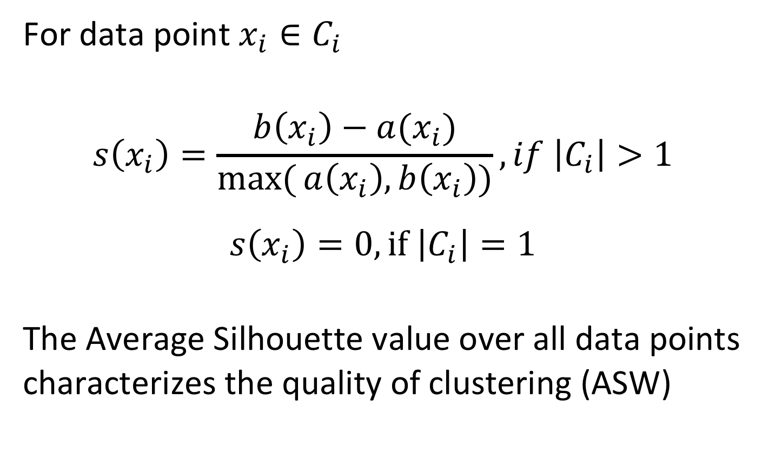
Silhouette Value
For data point $x_{i}∈C_{i}$
$$s\left(x_{i}\right)=\frac{b\left(x_{i}\right)−a(x_{i})}{\max_{}{(}a\left(x_{i}\right),b\left(x_{i}\right))}, if \left|C_{i}\right|>1$$
$s\left(x_{i}\right)=0, if$ $\left|C_{i}\right|=1$
The Average Silhouette value over all data points characterizes the quality of clustering (ASW)
Notes:
The Silhouette Value for a data point characterizes how the point “fits” into its own cluster. We can average this value over all data points to characterize the global quality of a clustering.

Slide 37
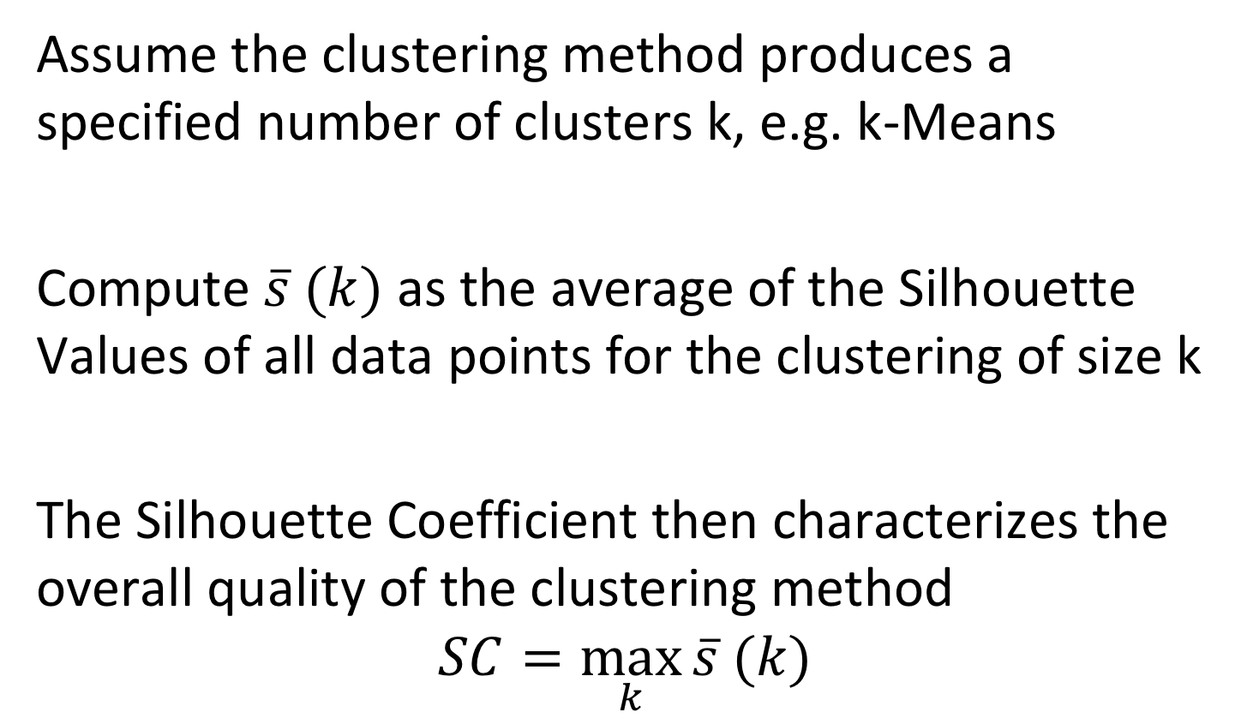
Silhouette Coefficient
Assume the clustering method produces a specified number of clusters k, e.g. k-Means
Compute $\overline{s} (k)$ as the average of the Silhouette Values of all data points for the clustering of size k
The Silhouette Coefficient then characterizes the overall quality of the clustering method
$$SC=\max_{k}{\overline{s} (k)}$$
Notes:
The Silhouette Coefficient can be used for tuning the parameter k for methods that produce a predefined number of cluster, such as k-Means. The maximum value that can so be achieved the Silhouette Coefficient then characterizes the overall quality of the chosen clustering method for the given clustering problem.

Slide 38
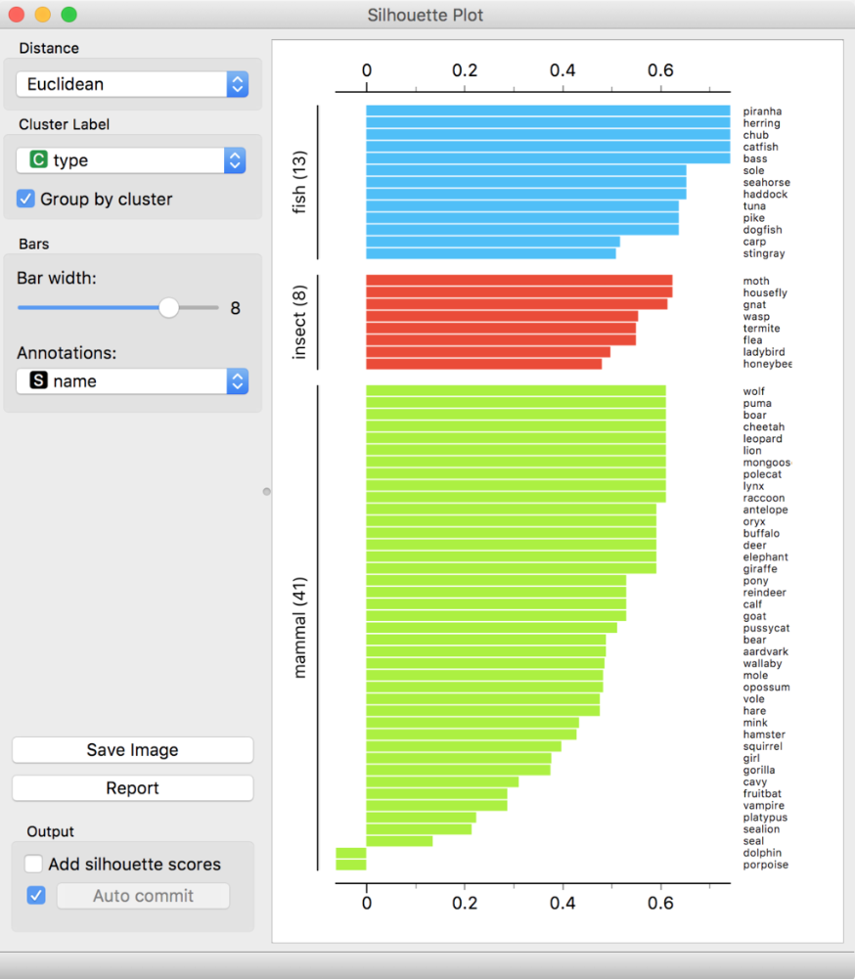
Example
Notes:
The Silhouette coefficients can also be used to analyse the quality of clusters, but also the quality of membership of individual data points to their clusters. In the above visualizations it can be seen that the last two data points in the orange cluster do not well fit to their cluster.
Image from: https://en.wikipedia.org/wiki/Silhouette_(clustering)

Slide 39
Discussion
AWS is one-size-fits all approach
Aims of clustering might be different
Between-cluster separation (e.g. image segmentation)
Within cluster homogeneity
Good representation of data by centroids (information representation)
Good representation of dissimilarity by clustering induced metric
Absence of gaps within clusters (social communities)
Uniform cluster sizes
Notes:
AWS is a popular measure, but one needs to be aware that it combines different aspects that are important to the evaluation of a clustering algorithm in a single measure. This is similar to the situation where precision and recall are aggregated into a single F-measure for information retrieval. Depending on the application different aspects of the properties of the resulting clusterings might be relevant. This can be captured through different measures.

Slide 40
Alternative Evaluation Measures
Thus choose one or more suitable metrics and aggregate them
p-separation index
Distance based density KNN index
Within cluster average distance
Within cluster distance to centroid
Entropy of cluster sizes
Average largest-within cluster gap
etc.
Notes:
Therefore many other measure have been proposed and might be considered. Also different measures might be combined into a single measure by aggregation, e.g. averaging their metrics.

Slide 41
References
Textbook
Jiawei Han, Data Mining: concepts and techniques, Morgan Kaufman, 2000, ISBN 1-55860-489-8

